Slide 1
The Limits to Growth: Sustainability and the Circular Economy
Lecture 07: Technology
Prof. Dr. Benjamin Leiding
M.Sc. Anant Sujatanagarjuna M.A. Theresa Sommer

Slide 2
License
This work is licensed under a Creative Commons Attribution-ShareAlike 4.0 International License. To view a copy of this license, please refer to https://creativecommons.org/licenses/by-sa/4.0/ .
Updated versions of these slides will be available in our Github repository.

Slide 3
Introduction

Slide 4
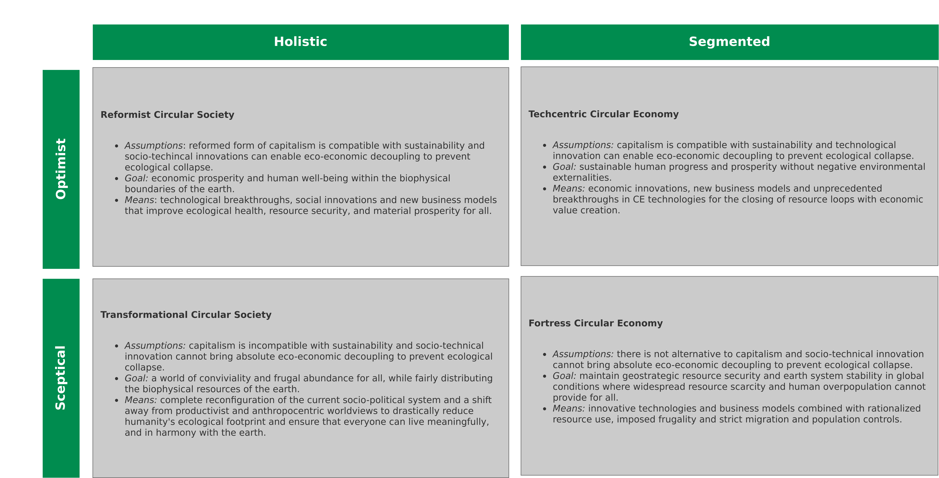
Introduction
CE/CS and Technology
Image recreated from: M. C. Friant, R. Salomone, W. J. V. Vermeulen (2020) – A Typology of Circular Economy Discourses: Navigating the Diverse Visions of a Contested Paradigm – Link

Slide 5
Carbon Capture and Storage

Slide 6
Carbon Capture and Storage
Introduction
Too much CO2? → Lets put it “somewhere”

Slide 7
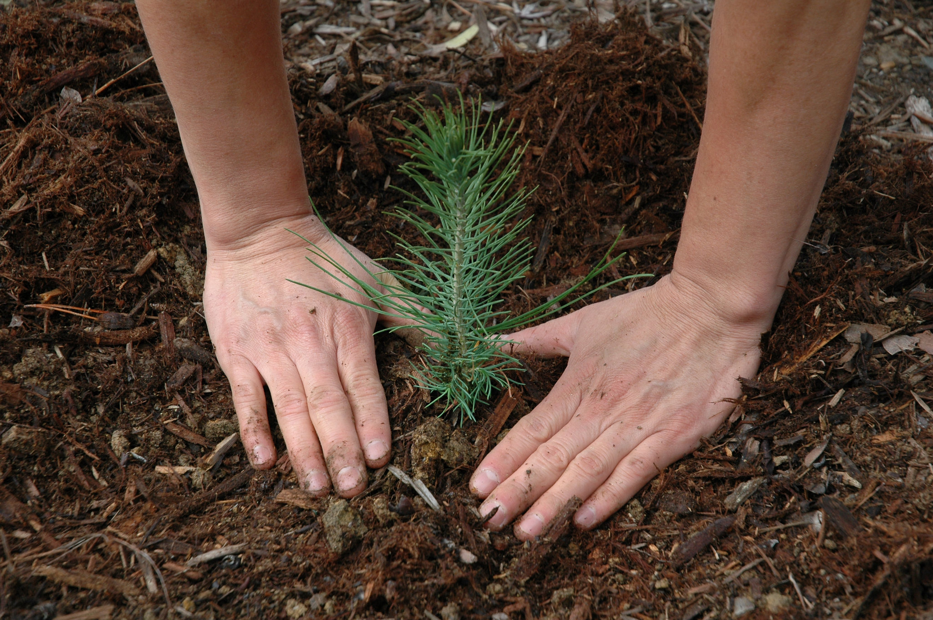
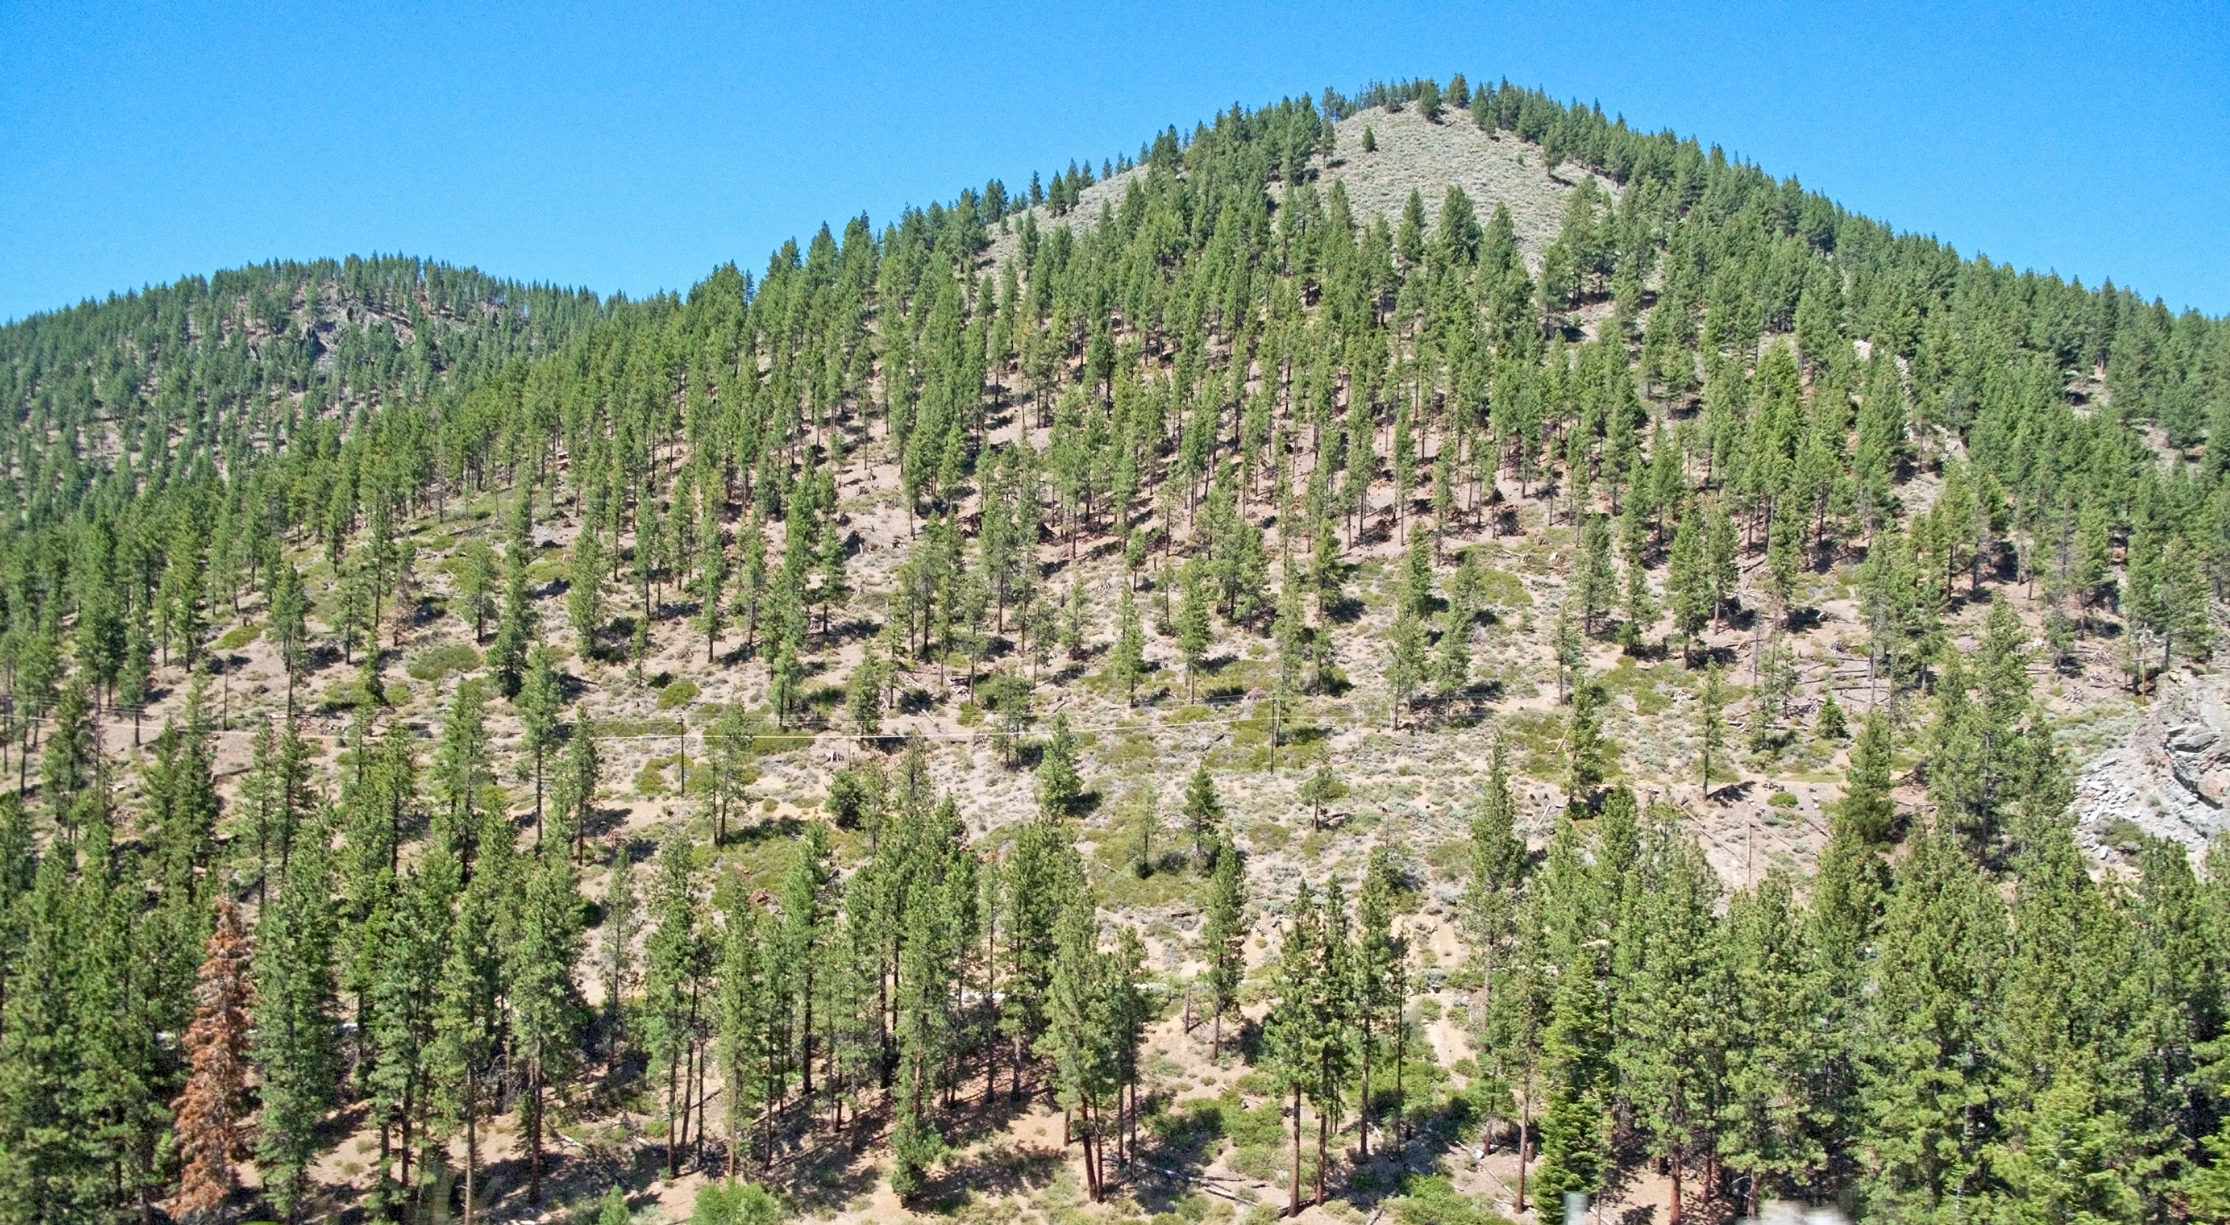
Carbon Capture and Storage
Reforestation
1. Pacific Southwest Forest Service, USDA – https://www.flickr.com/photos/usfsregion5/3598029211 – CC BY 2.0
2. Downtowngal – https://upload.wikimedia.org/wikipedia/commons/3/30/Reforestation%2C_Lake_Tahoe_area.jpg – CC BY-SA 3.0

Slide 8
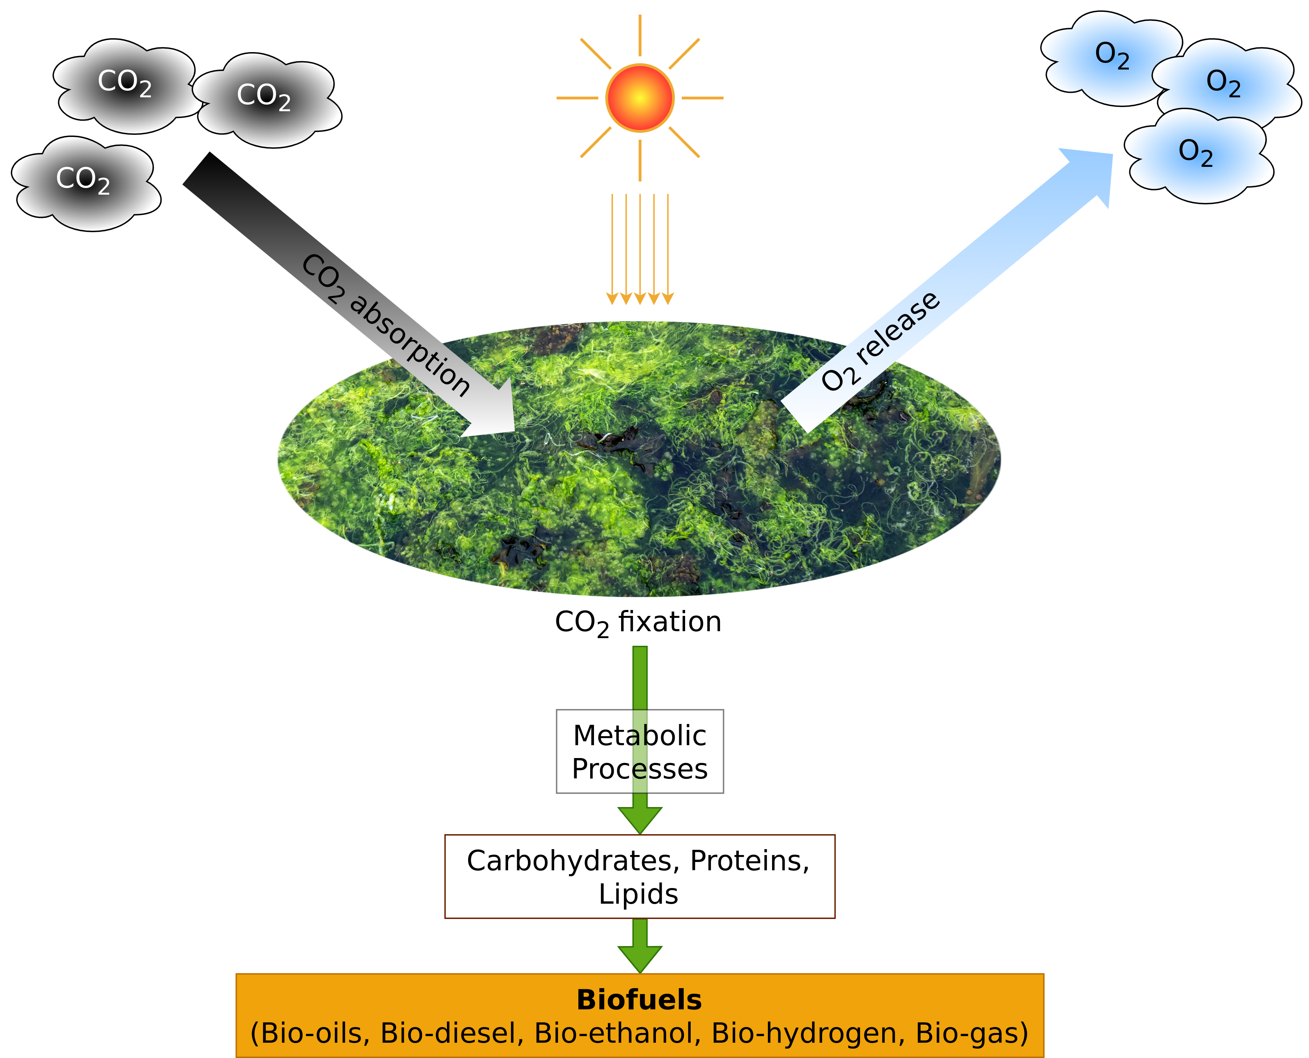
Carbon Capture and Storage
Biological Carbon Capture
Image adapted from: K.K. Jaiswal, S. Dutta, I. Banerjee, C.B. Pohrmen, V. Kumar (2021) – Photosynthetic microalgae–based carbon sequestration and generation of biomass in biorefinery approach for renewable biofuels for a cleaner environment – Link.

Slide 9
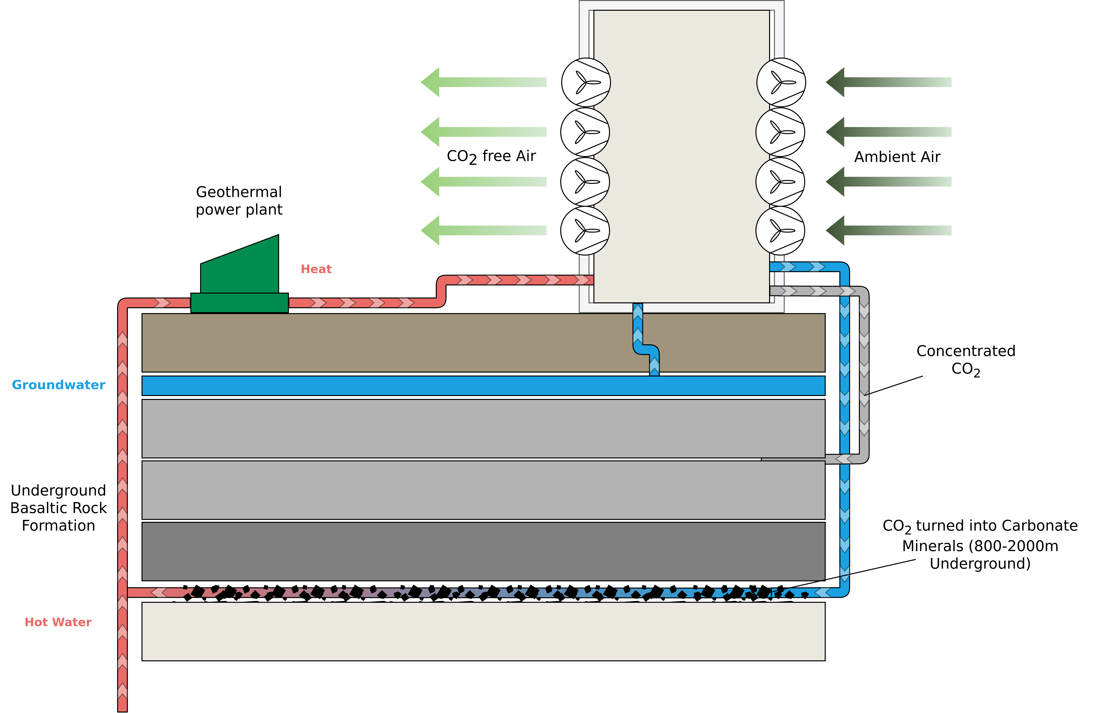
Carbon Capture and Storage
Carbon Mineralisation
Image adapted from: Climeworks (2022) – https://climeworks.com/co2-removal

Slide 10
Alternative Sources of energy

Slide 11
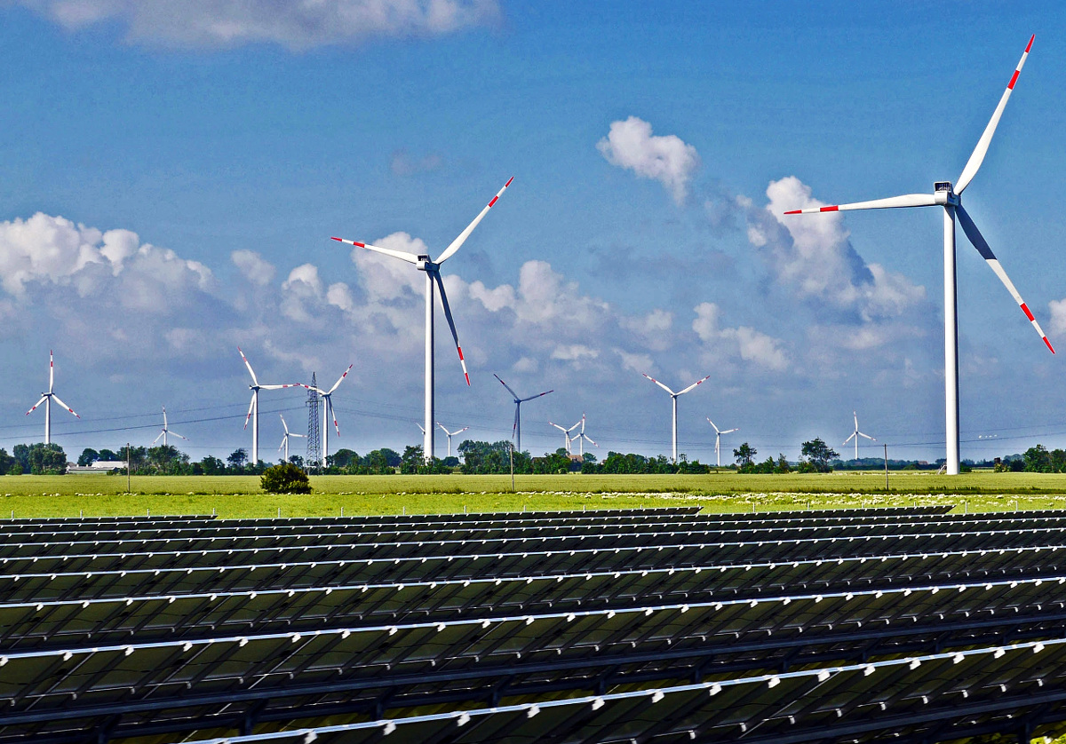
Alternative Sources of Energy
Wind and Solar Farms
hpgruesen – https://upload.wikimedia.org/wikipedia/commons/3/32/Renewable_energy_park.jpg – CC0

Slide 12
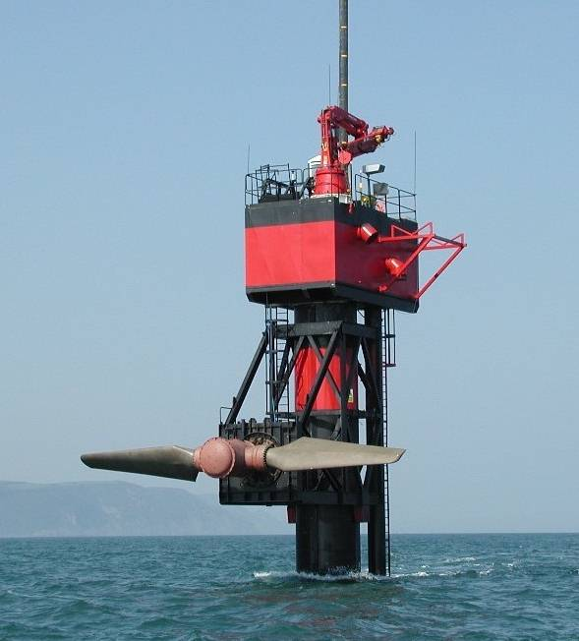
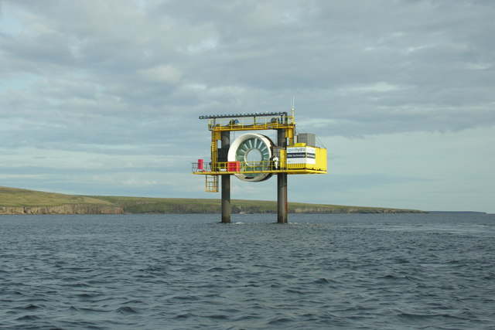
Alternative Sources of Energy
Tidal Power
1. Fundy – https://upload.wikimedia.org/wikipedia/commons/2/25/Seaflow_raised_16_jun_03.jpg – CC BY-SA 3.0
2. George Brown – https://upload.wikimedia.org/wikipedia/commons/d/d8/Eday_Tidal_Generator%2C_Fall_of_Warness_-_geograph.org.uk_-_1884742.jpg – CC BY-SA 2.0

Slide 13
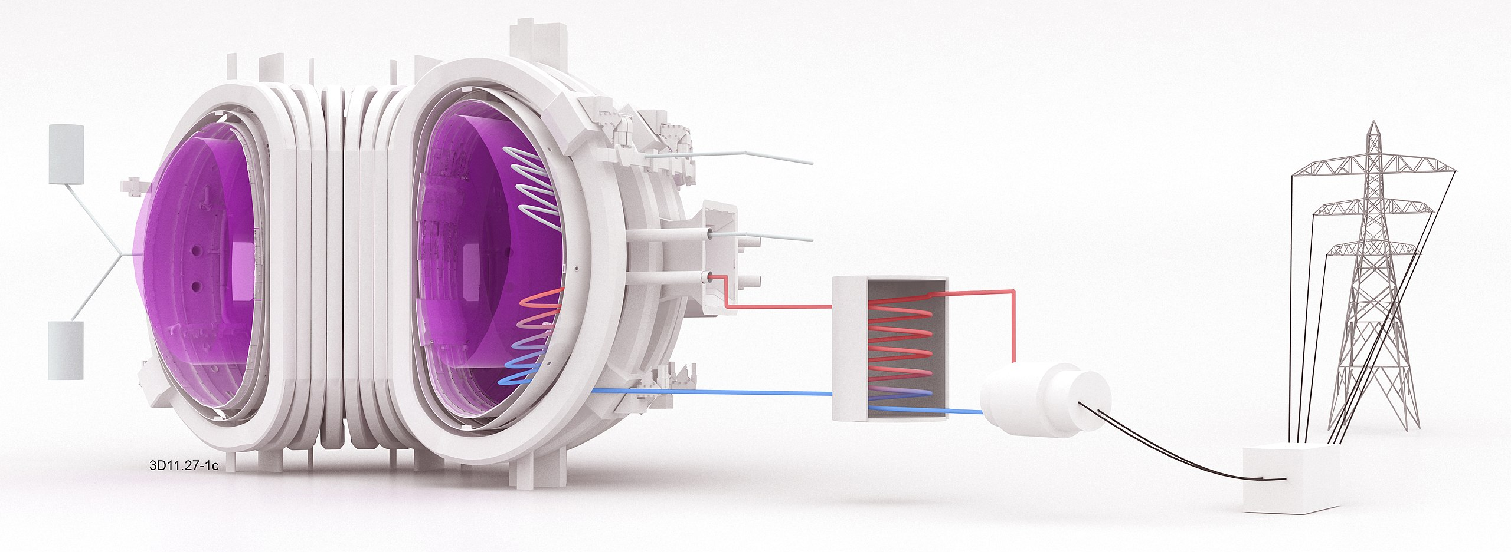
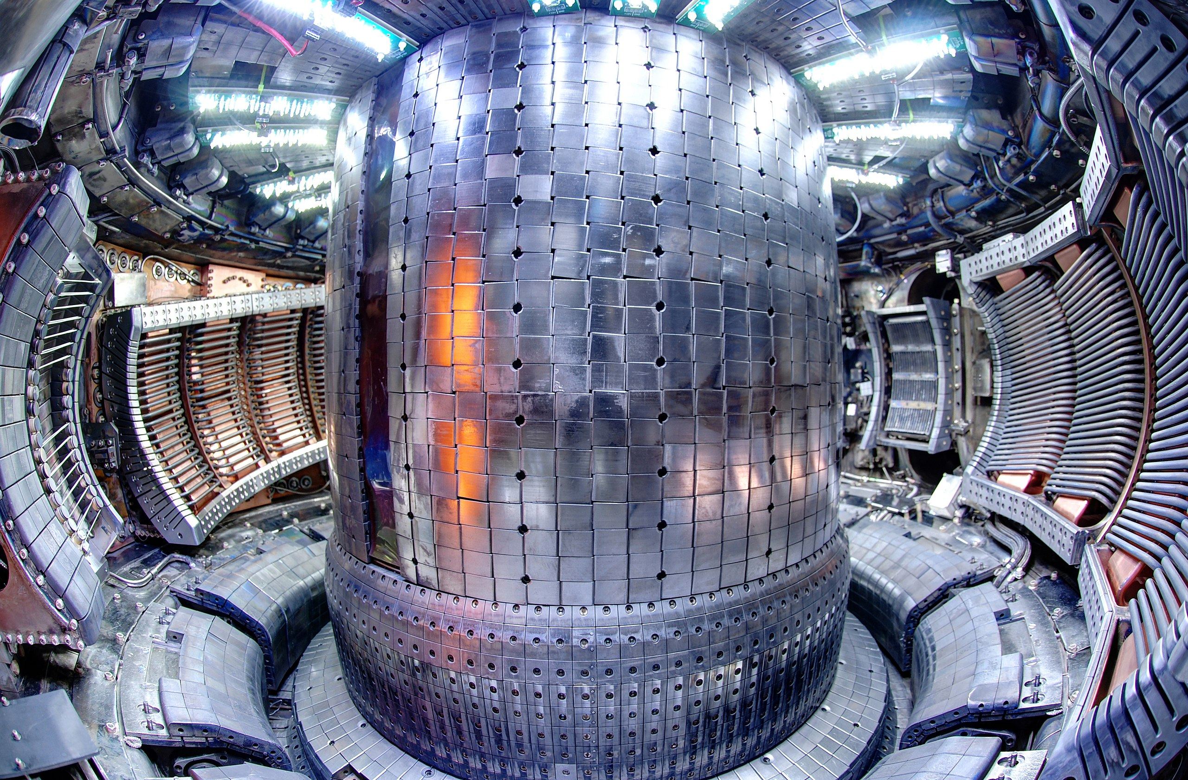
Alternative Sources of Energy
Fusion Power
1. EUROfusion – https://upload.wikimedia.org/wikipedia/commons/e/e9/EUROfusion_schematic_diagram_of_fusion_power_plant.jpg – CC BY-SA 4.0
2. Robert Mumgaard – https://upload.wikimedia.org/wikipedia/commons/8/89/Alcator_C-Mod_Fisheye_from_Fport.jpg –CC BY-SA 3.0

Slide 14
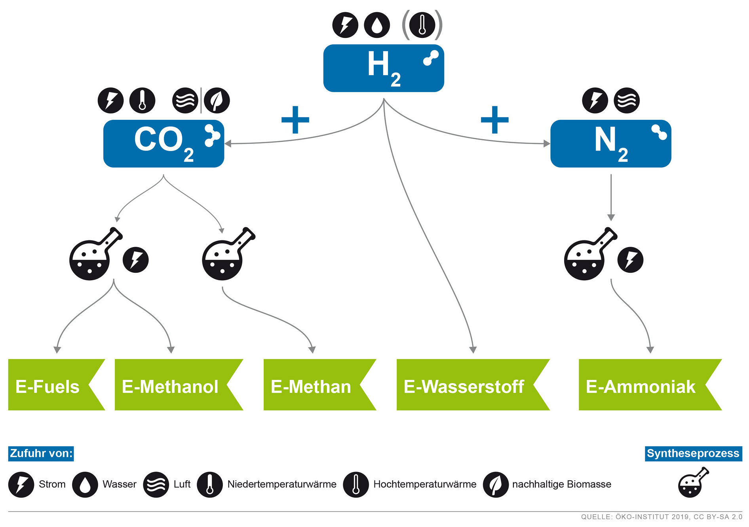
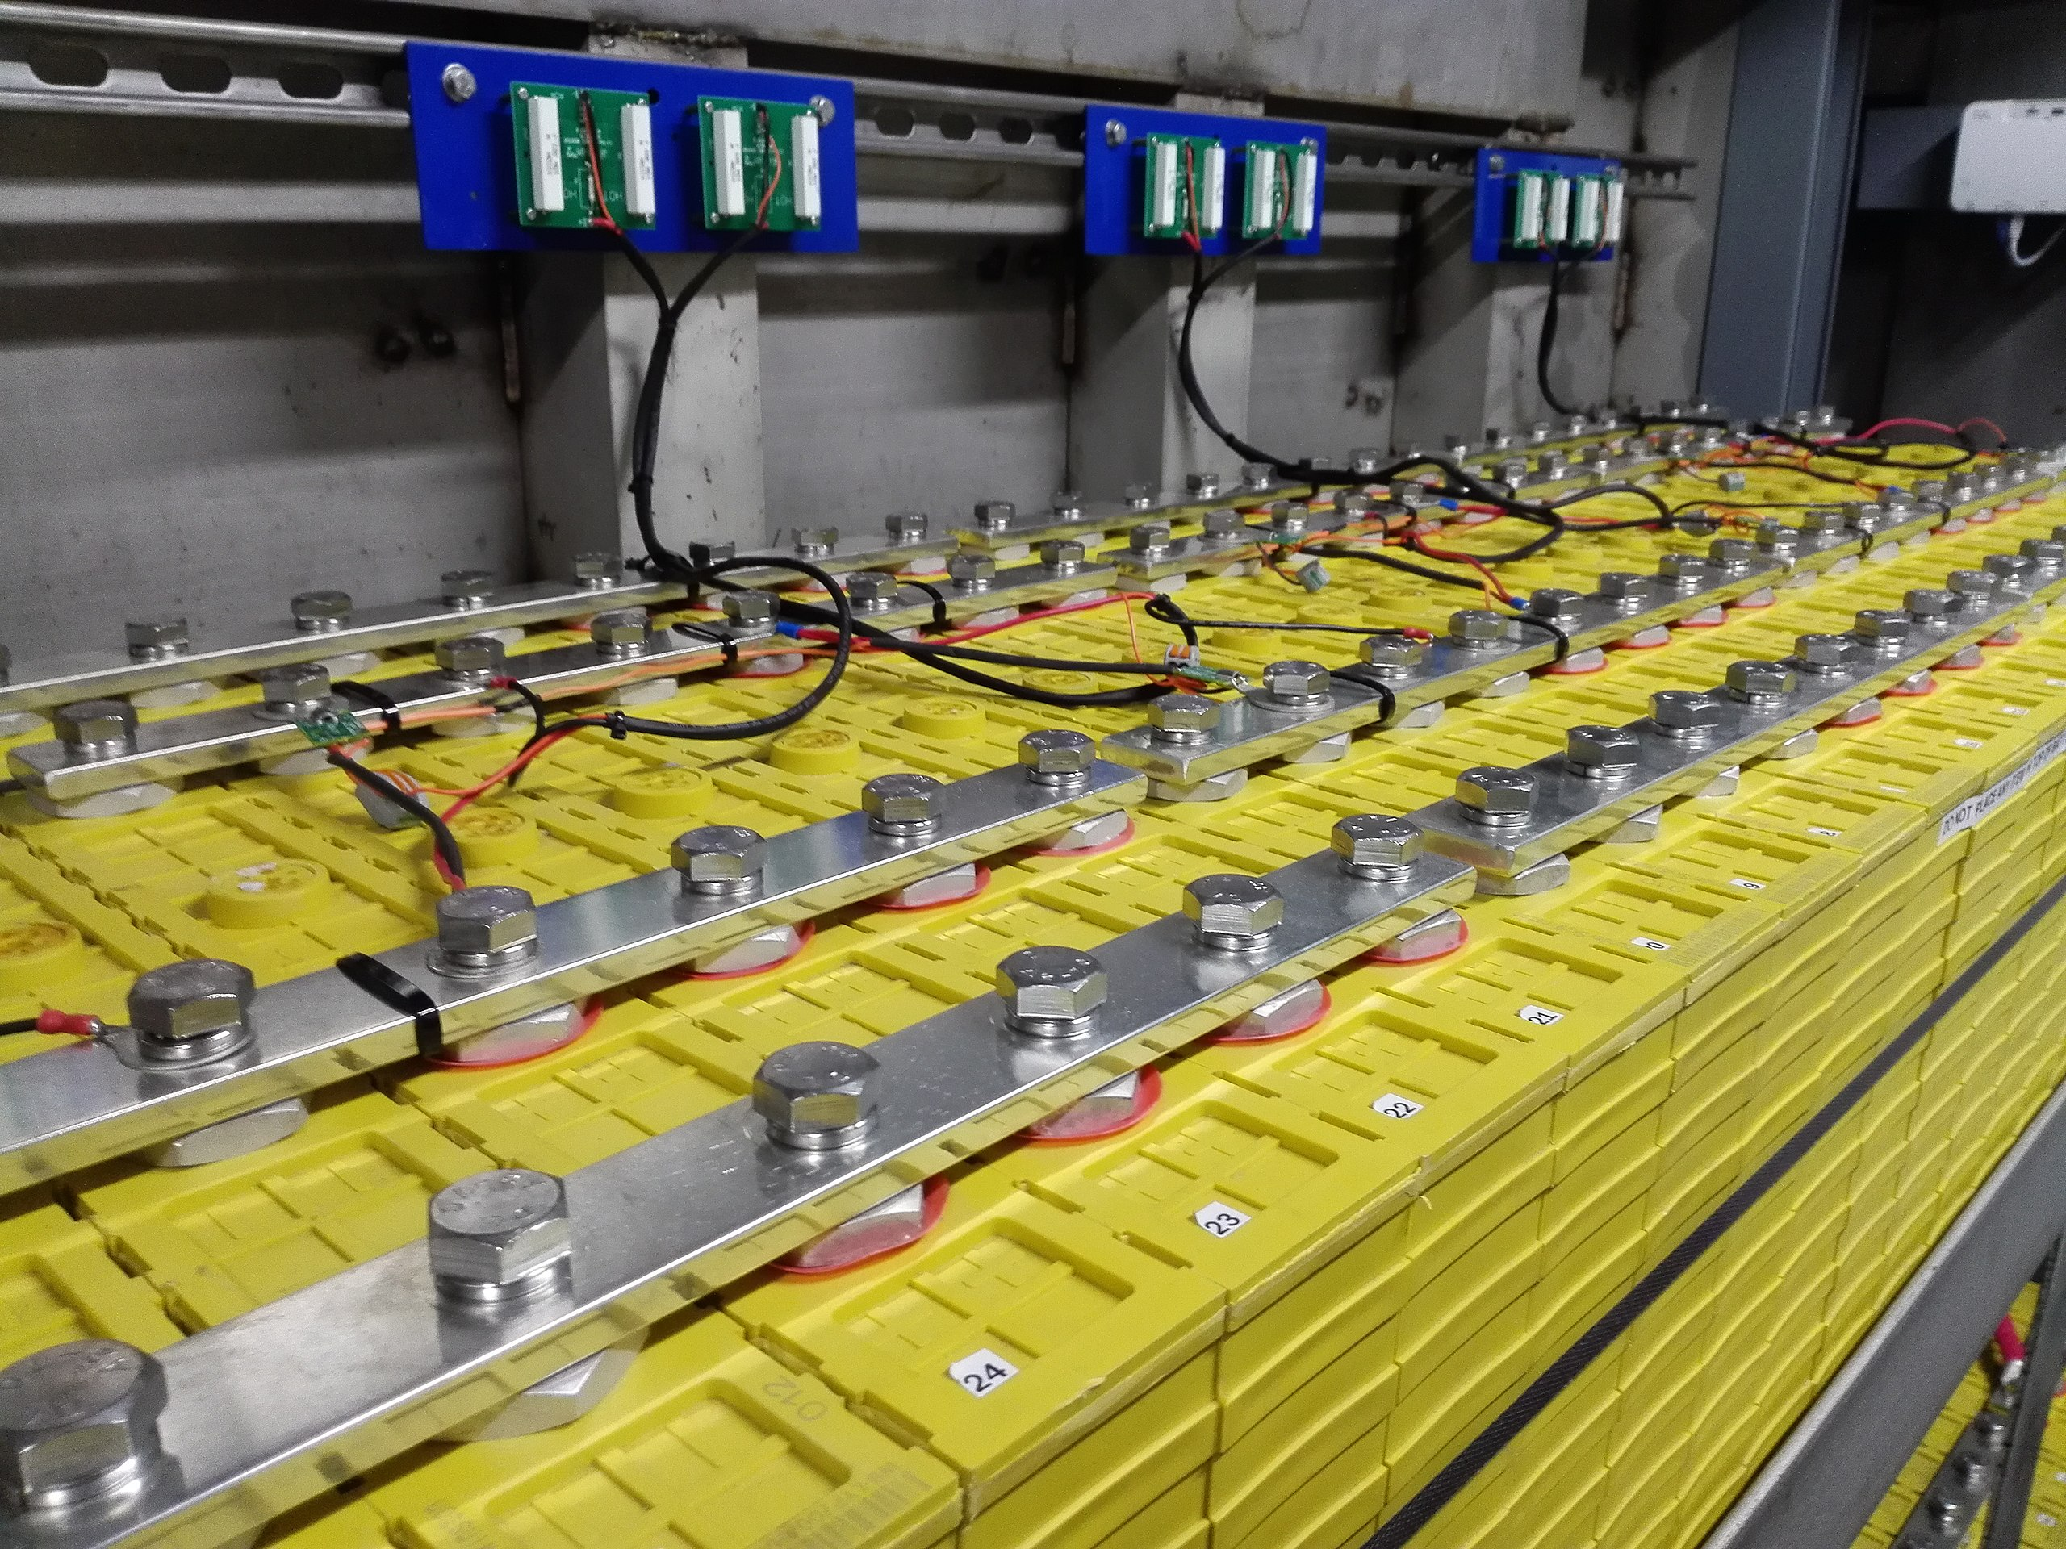
Alternative Sources of Energy
Power-to-X
1. Yo-Co-Man – https://upload.wikimedia.org/wikipedia/commons/0/08/Lithium_Iron_Phosphate_LiFePO4_Cells_700Ah_in_Parallel_and_Series_and_Busbar_-_1.jpg – CC BY-SA 4.0
2. Oeko-Institute e.V. – https://www.flickr.com/photos/oekoinstitut/48378513216 – CC BY-SA 2.0

Slide 15
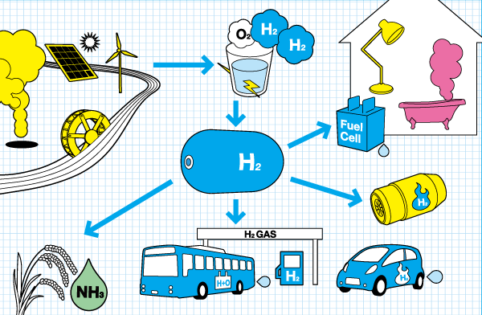
Alternative Sources of Energy
Green Hydrogen
Rh2netwrok – https://upload.wikimedia.org/wikipedia/commons/6/6f/RH2cycle.png – CC BY-SA 3.0

Slide 16
Electrification / Decarbonization

Slide 17
Electrification / Decarbonization
Electrify Everything (e.g. your home)
Rooftop solar panels
Home storage battery
Battery electric vehicles (bidirectional charging)
Electric cooking
Heat pump
Heating / cooling
Water heater
Dryer (clothes)
Etc.
Why? → Your home directly benefits (“more green”) from the general electric grid moving towards renewable energies.

Slide 18
Electrification / Decarbonization
Electrify Everything (e.g. your home)
Rooftop solar panels
Home storage battery
Battery electric vehicles (bidirectional charging)
Electric cooking
Heat pump
Heating / cooling
Water heater
Dryer (clothes)
Etc.
Why? → Your home directly benefits (“more green”) from the general electric grid moving towards renewable energies.

Slide 19
Electrification / Decarbonization
Electrify Everything (e.g. your home)
Rooftop solar panels
Home storage battery
Battery electric vehicles (bidirectional charging)
Electric cooking
Heat pump
Heating / cooling
Water heater
Dryer (clothes)
Etc.
Why? → Your home directly benefits (“more green”) from the general electric grid moving towards renewable energies.

Slide 20
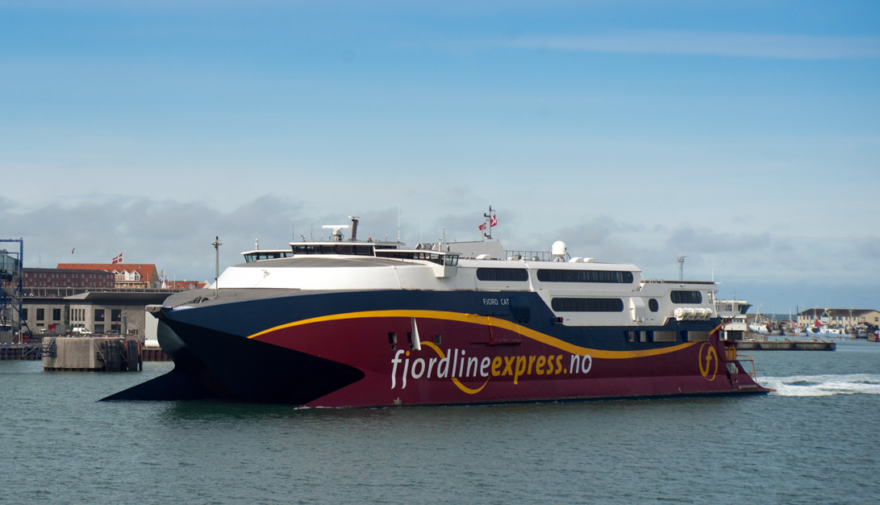
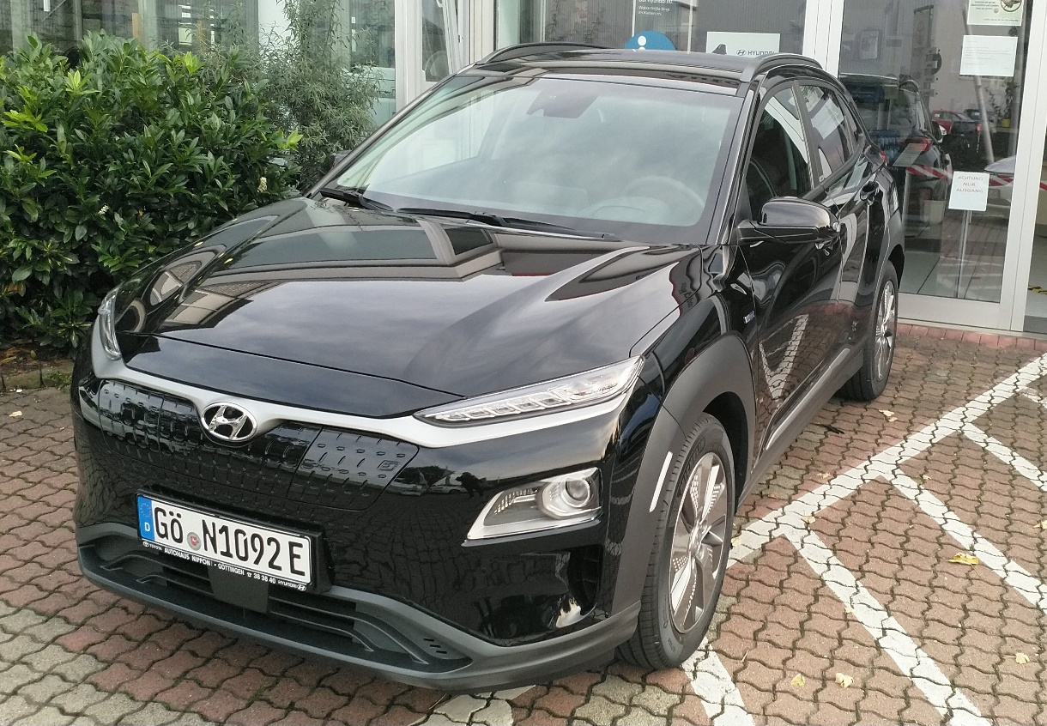
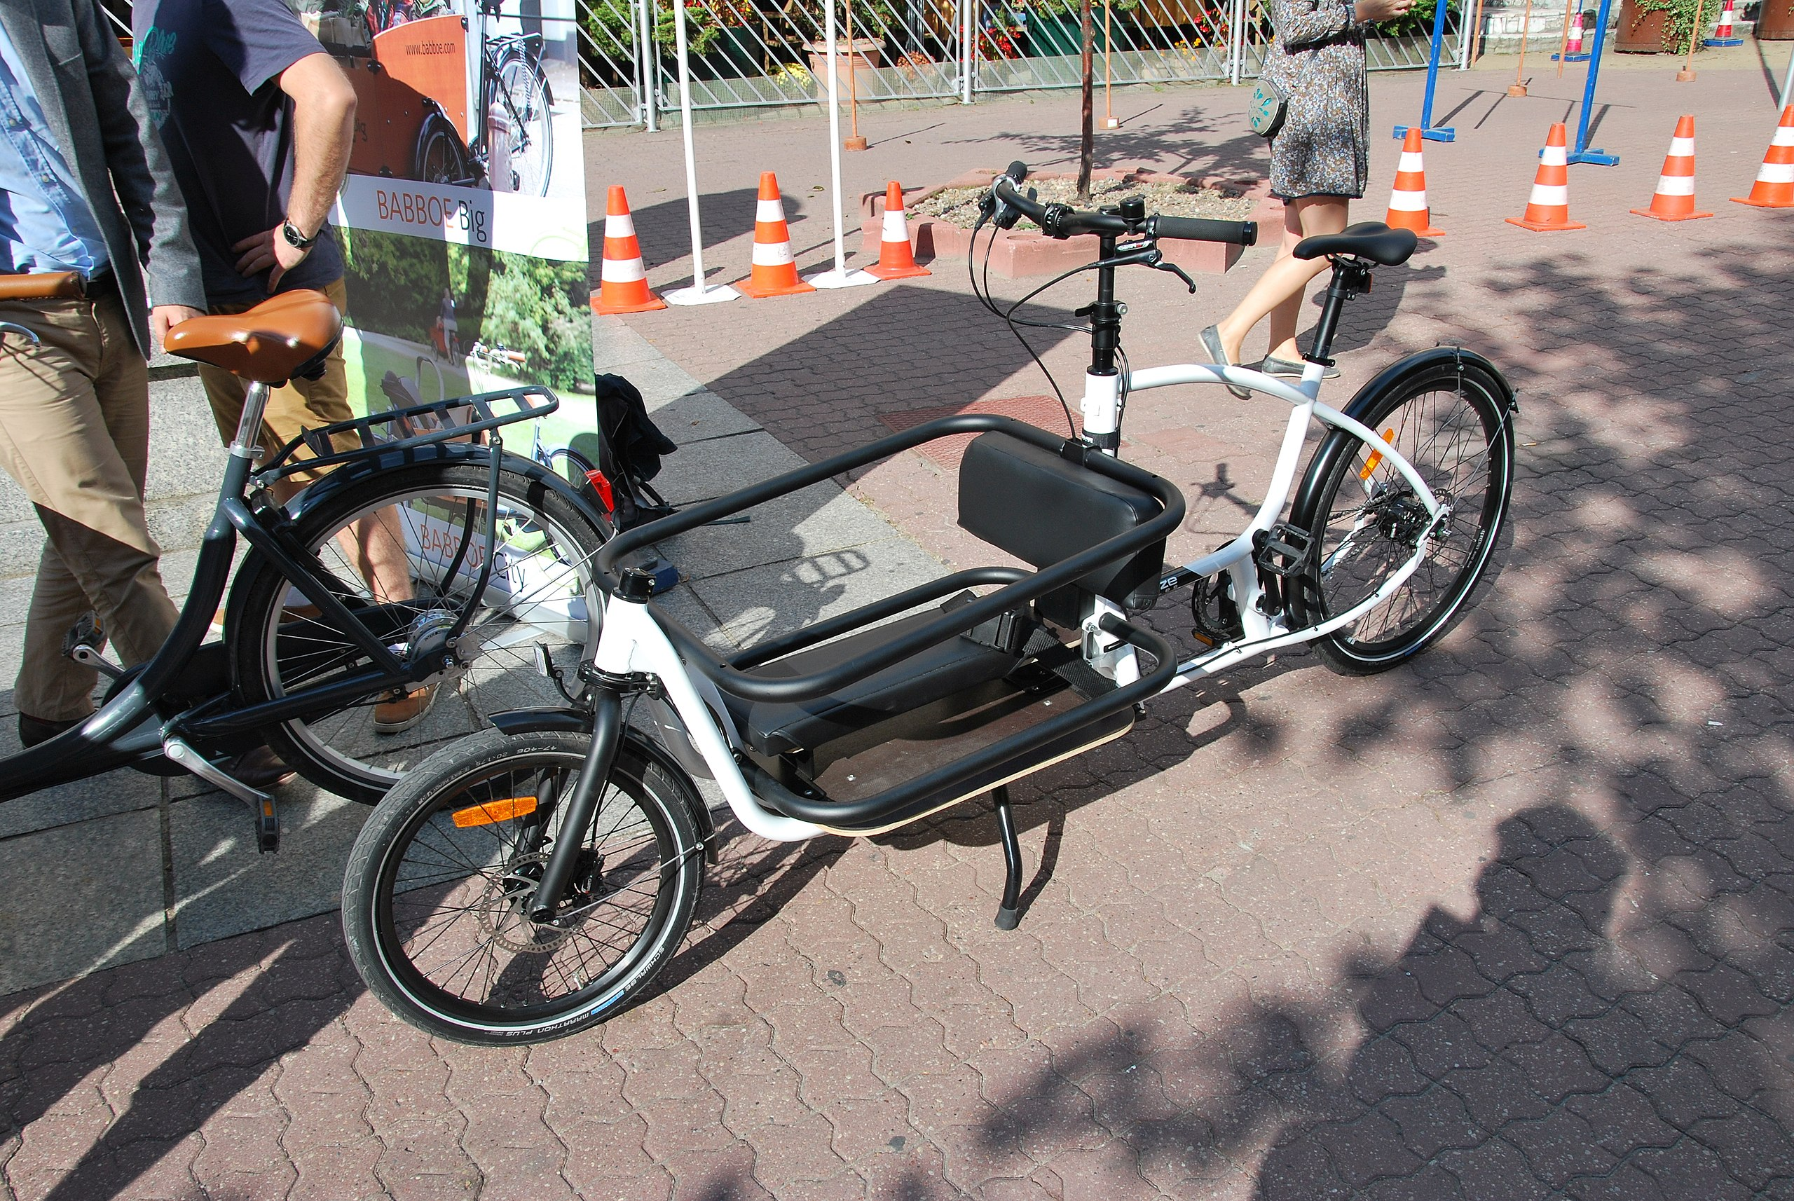
Electrification / Decarbonization
Alternative Forms of Transportation
1. Benjamin Leiding – CC BY-SA 4.0.
2. Fanny Schertzer – https://upload.wikimedia.org/wikipedia/commons/8/87/Hsc_fjord_cat_hirtshals.jpg – CC BY-SA 3.0
3. Zorro2212 – https://upload.wikimedia.org/wikipedia/commons/a/a0/European_Sustainable_Mobility_Week_in_%C5%81%C3%B3d%C5%BA_September_2015_09.jpg – CC BY-SA 4.0

Slide 21
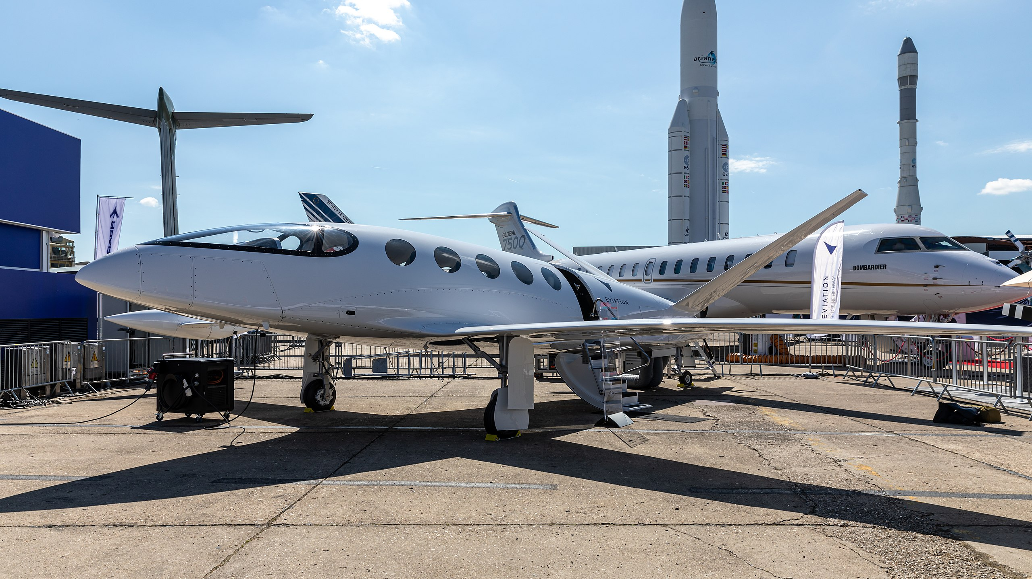
Electrification / Decarbonization
Alternative Forms of Transportation
Matti Blume – https://upload.wikimedia.org/wikipedia/commons/b/ba/Eviation_Alice%2C_Paris_Air_Show_2019%2C_Le_Bourget_%28SIAE8856%29.jpg – CC BY-SA 4.0

Slide 22


Electrification / Decarbonization
Alternative Forms of Transportation
1.Matti Blume – https://upload.wikimedia.org/wikipedia/commons/b/ba/Eviation_Alice%2C_Paris_Air_Show_2019%2C_Le_Bourget_%28SIAE8856%29.jpg – CC BY-SA 4.0
2.Benjamin Leiding – CC BY-SA 4.0.

Slide 23
Electrification / Decarbonization
Alternative Forms of Transportation
1.Matti Blume – https://upload.wikimedia.org/wikipedia/commons/b/ba/Eviation_Alice%2C_Paris_Air_Show_2019%2C_Le_Bourget_%28SIAE8856%29.jpg – CC BY-SA 4.0
2.Benjamin Leiding – CC BY-SA 4.0.

Slide 24
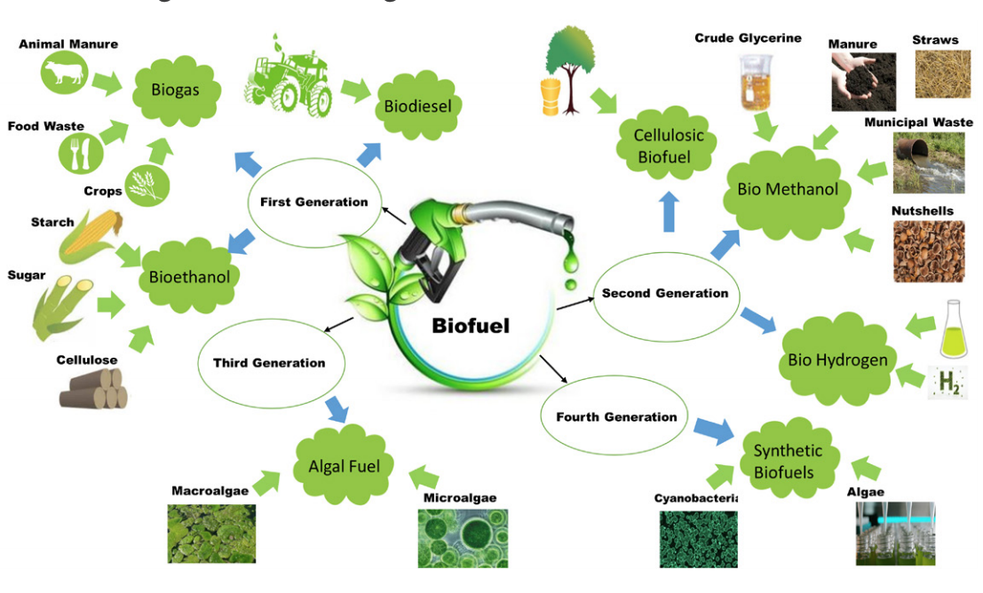
Electrification / Decarbonization
Biofuel
Muhammad Rizwan Javed, Muhammad Junaid Bilal, Muhammad Umer Farooq Ashraf, Aamir Waqar, Muhammad Aamer Mehmood, Maida Saeed and Naima Nashat. – https://upload.wikimedia.org/wikipedia/commons/d/d9/Types_and_generation_of_biofuels.png – CC BY-SA 4.0

Slide 25
Climate-resilient Food Production

Slide 26
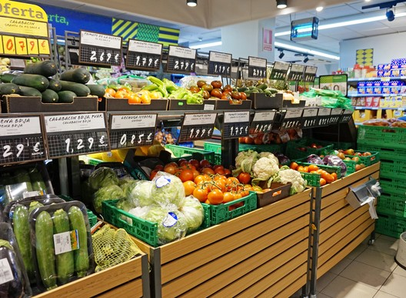
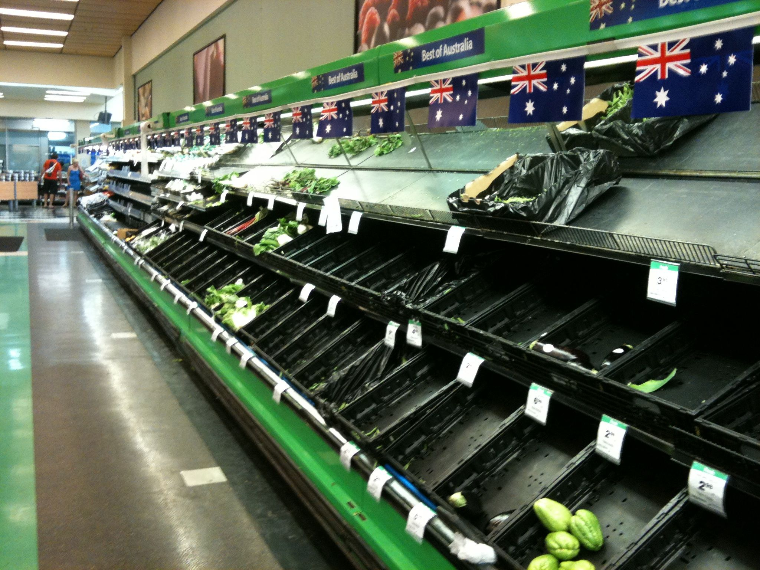
Climate-Resilient Food Production
Introduction
1. Tiia Monto – https://commons.wikimedia.org/wiki/File:Vegetables_in_supermarket.jpg – CC BY-SA 3.0.
2. Martin Shaw – https://commons.wikimedia.org/wiki/File:Vegetable_section_empty_in_a_supermarket_in_Kenmore.jpg – CC BY 2.0.

Slide 27
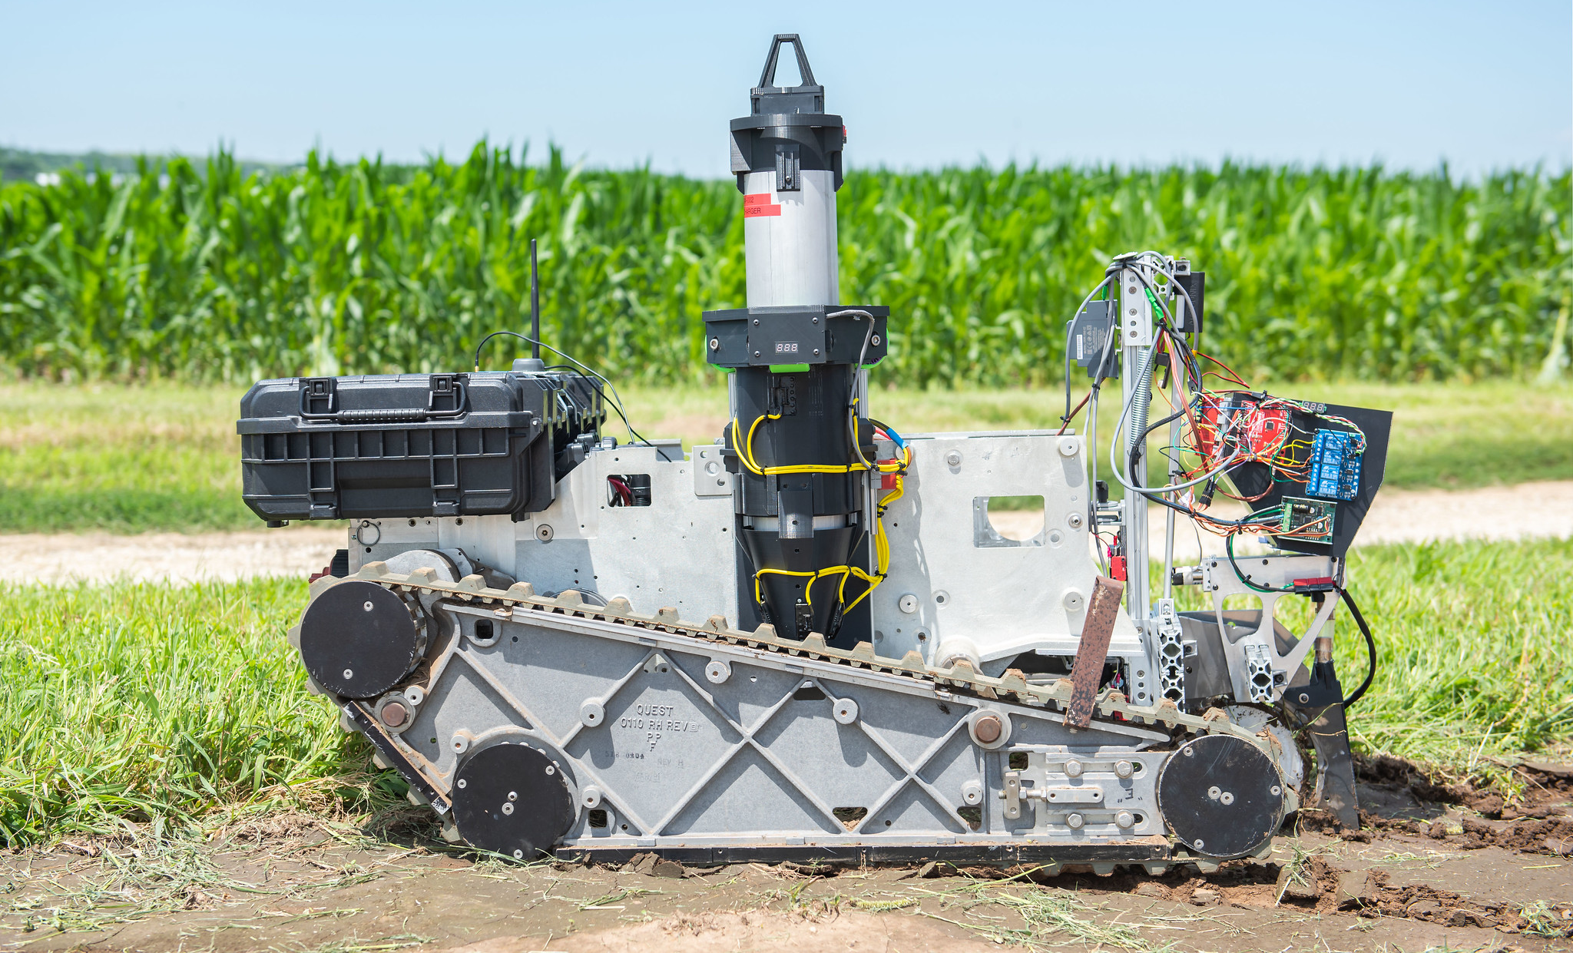
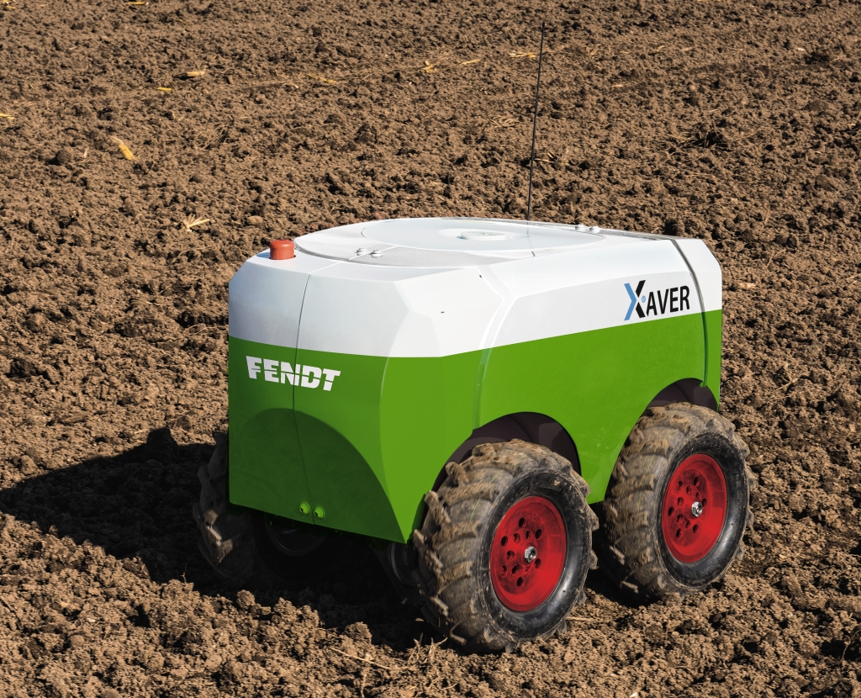
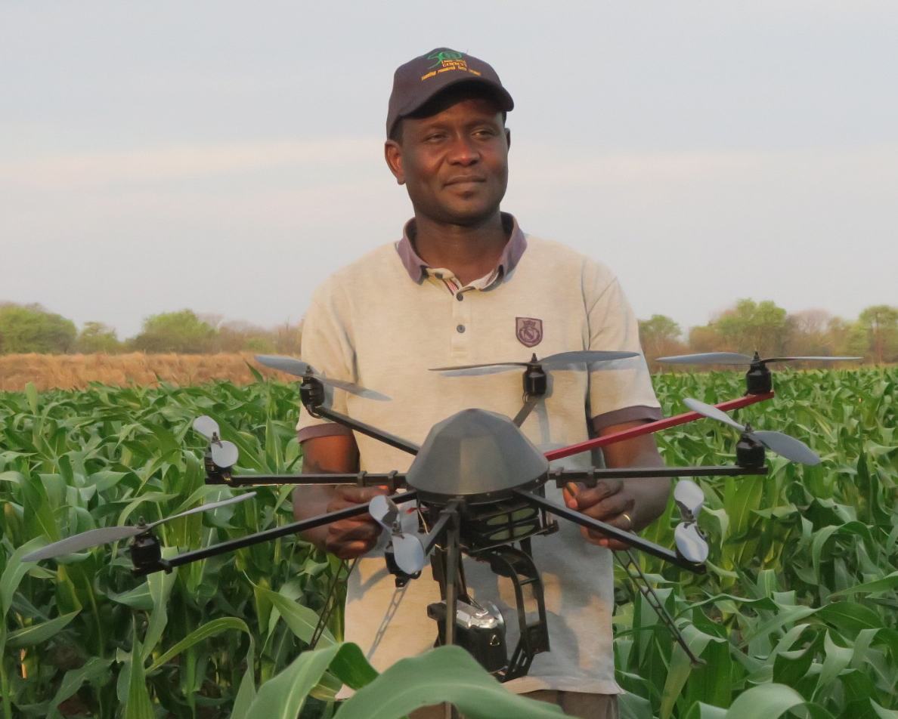
Climate-Resilient Food Production
Smart Farming
1. AGCO-Fendt – https://upload.wikimedia.org/wikipedia/commons/b/b3/Fendt_Xaver.jpg – CC BY-SA 4.0.
2. K-State Research and Extension – https://www.flickr.com/photos/ksrecomm/49090900066 – CC BY 2.0.
3. Climate Change, Agriculture and Food Security – https://www.flickr.com/photos/cgiarclimate/30947602551 – CC BY-NC-SA 2.0.

Slide 28
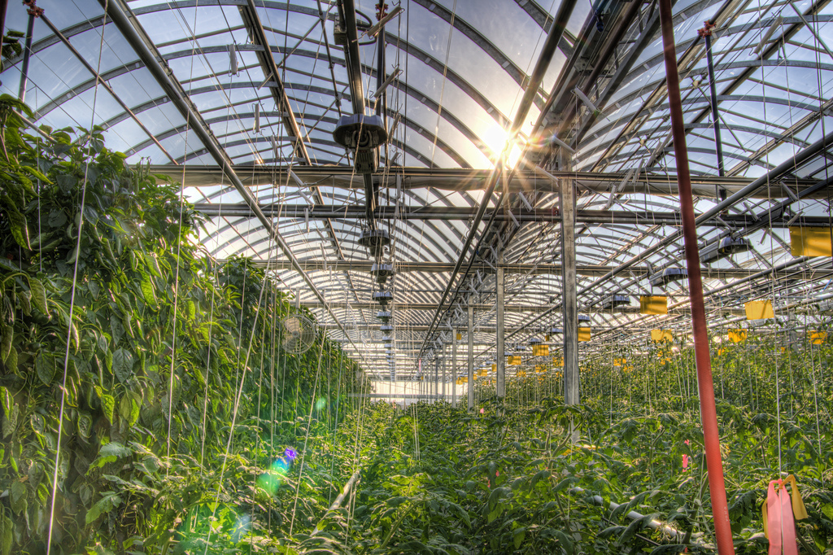
Climate-Resilient Food Production
Indoor Farming
Fadi Hage. – https://upload.wikimedia.org/wikipedia/commons/9/9f/Lufa_Farms_Montreal_rooftop_greenhouse.jpg – CC BY-SA 3.0

Slide 29
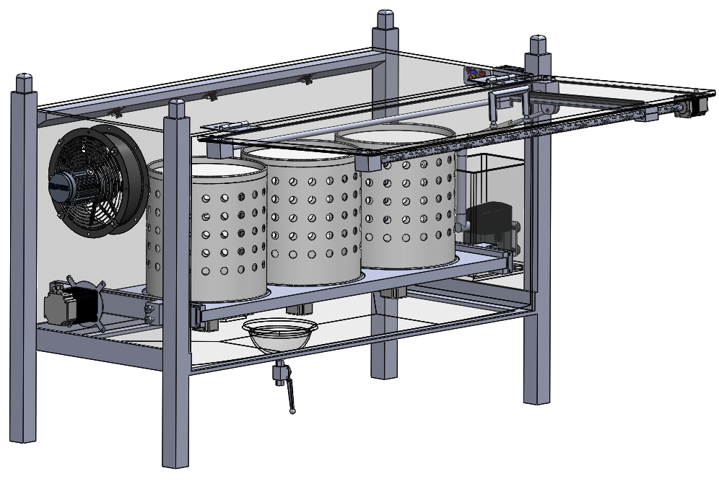
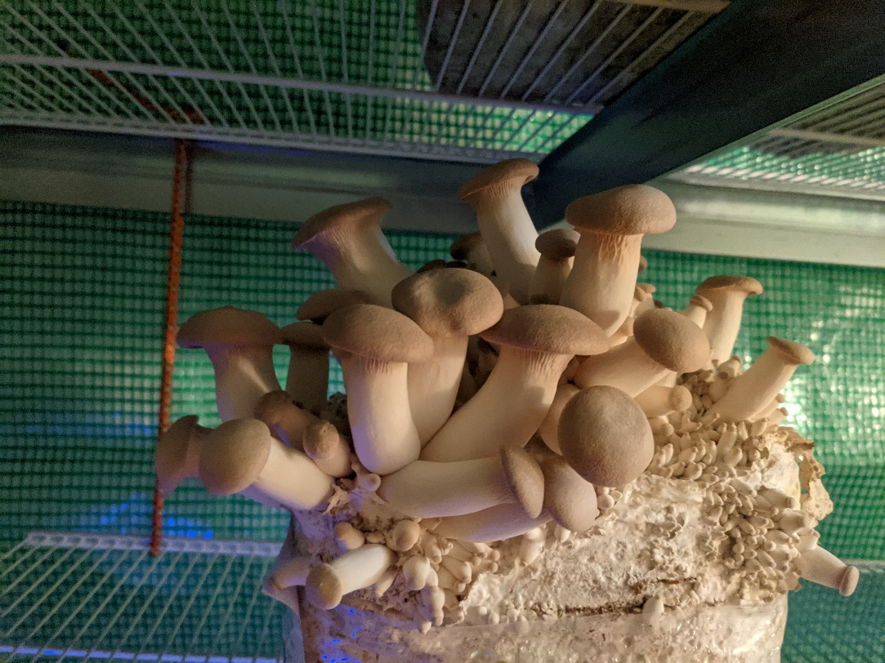
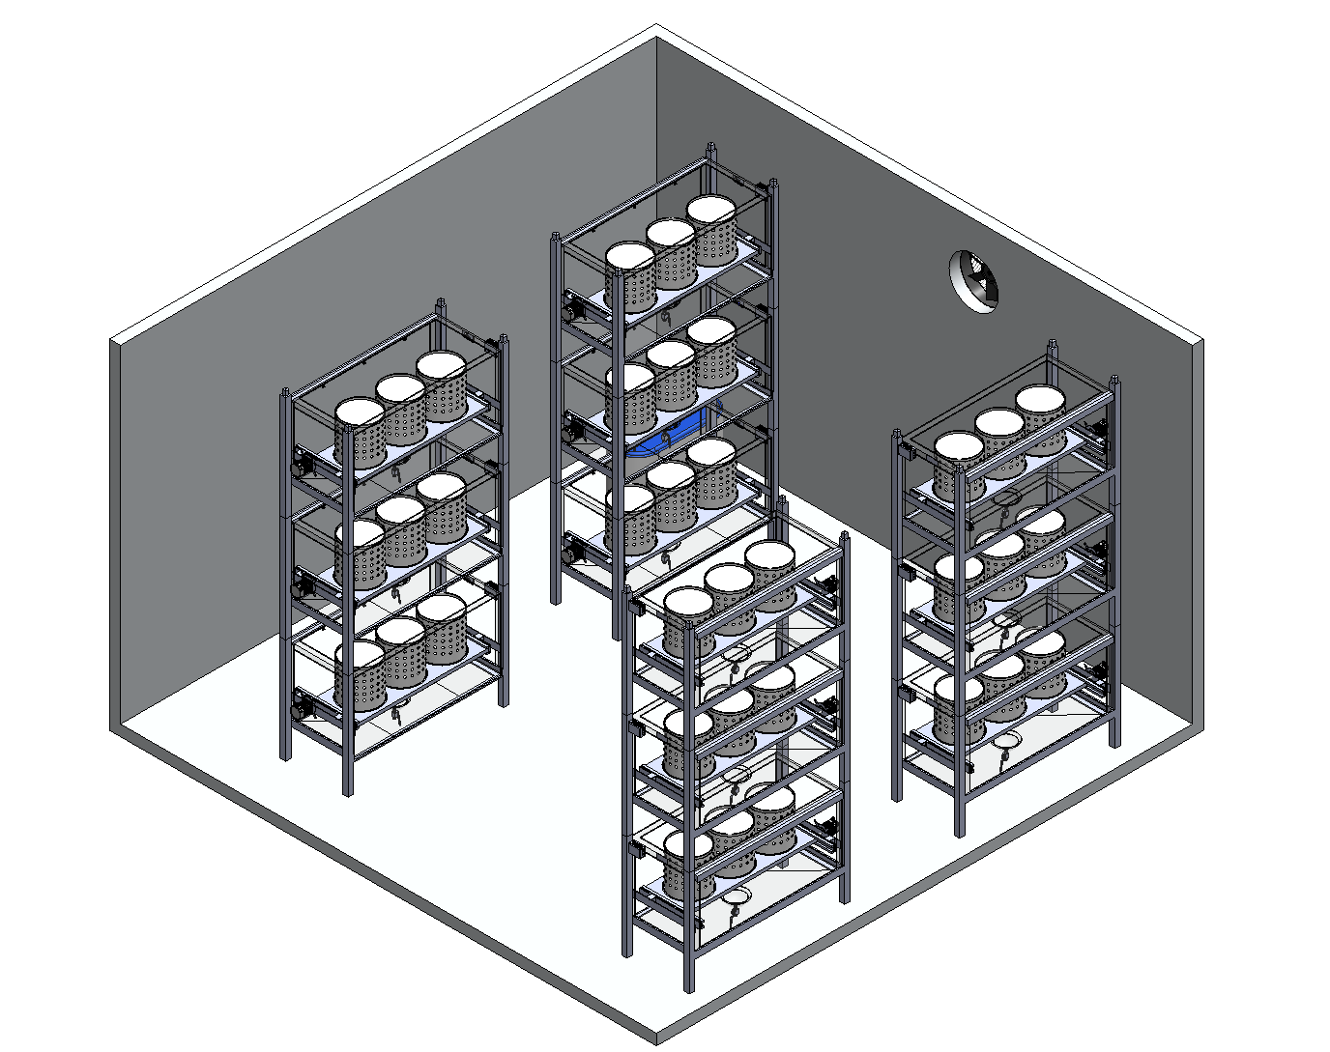
Climate-Resilient Food Production
Indoor Farming – Vegetables to Mushrooms
Benjamin Leiding – CC BY-SA 4.0
Dominique Briechle – CC BY-SA 4.0

Slide 30
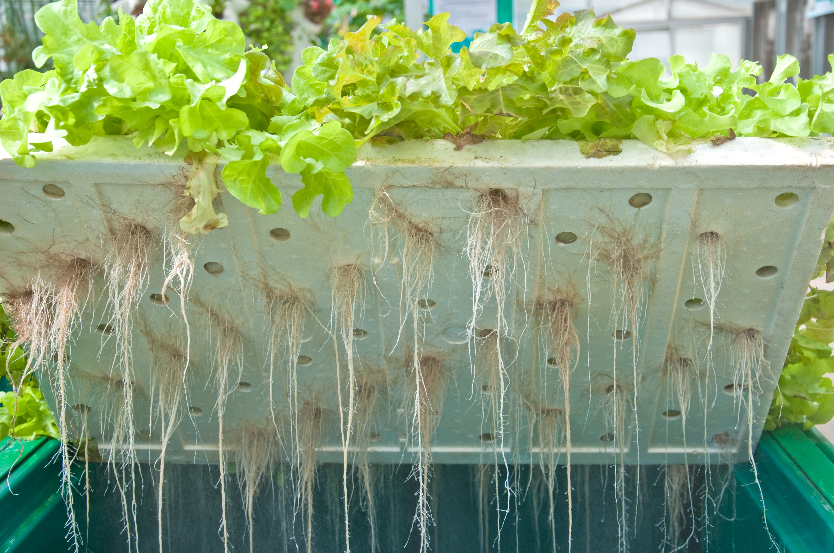
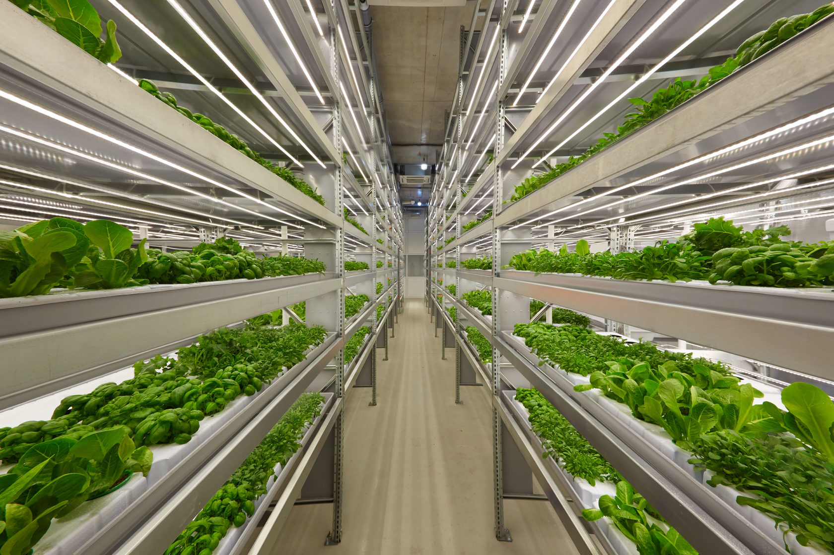
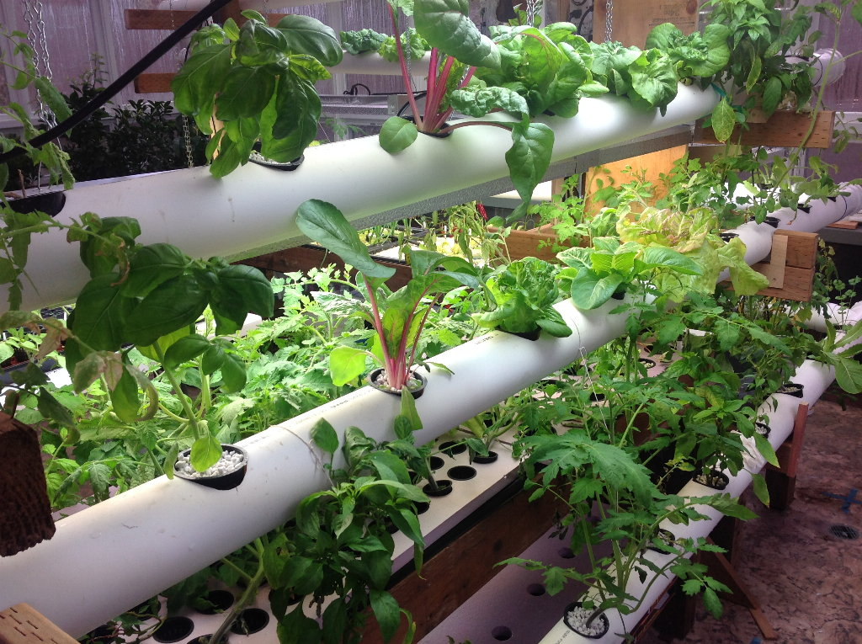
Climate-Resilient Food Production
Vertical Farming
1. ifarm.fi – https://upload.wikimedia.org/wikipedia/commons/5/5a/IFarm.fi_Vertical_farm_Finland.jpg – CC BY-SA 4.0.
2. ILRI – Aeroponics – https://www.flickr.com/photos/ilri/28664986336 – CC BY-NC-ND 2.0.
3. Aqua Mechanical – https://www.flickr.com/photos/aquamech-utah/24443777644 – CC BY 2.0
4. Oregon State University – https://upload.wikimedia.org/wikipedia/commons/3/36/Hydroponics_%2833185459271%29.jpg – CC BY-SA 2.0

Slide 31
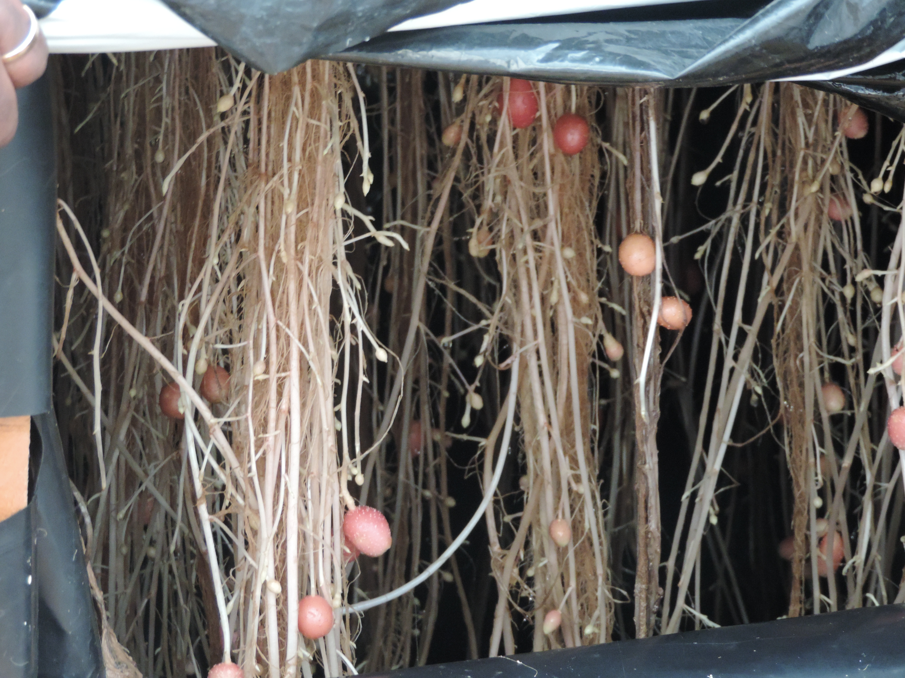
Climate-Resilient Food Production
Vertical Farming
1. ifarm.fi – https://upload.wikimedia.org/wikipedia/commons/5/5a/IFarm.fi_Vertical_farm_Finland.jpg – CC BY-SA 4.0.
2. ILRI – Aeroponics – https://www.flickr.com/photos/ilri/28664986336 – CC BY-NC-ND 2.0.
3. Aqua Mechanical – https://www.flickr.com/photos/aquamech-utah/24443777644 – CC BY 2.0
4. Oregon State University – https://upload.wikimedia.org/wikipedia/commons/3/36/Hydroponics_%2833185459271%29.jpg – CC BY-SA 2.0

Slide 32
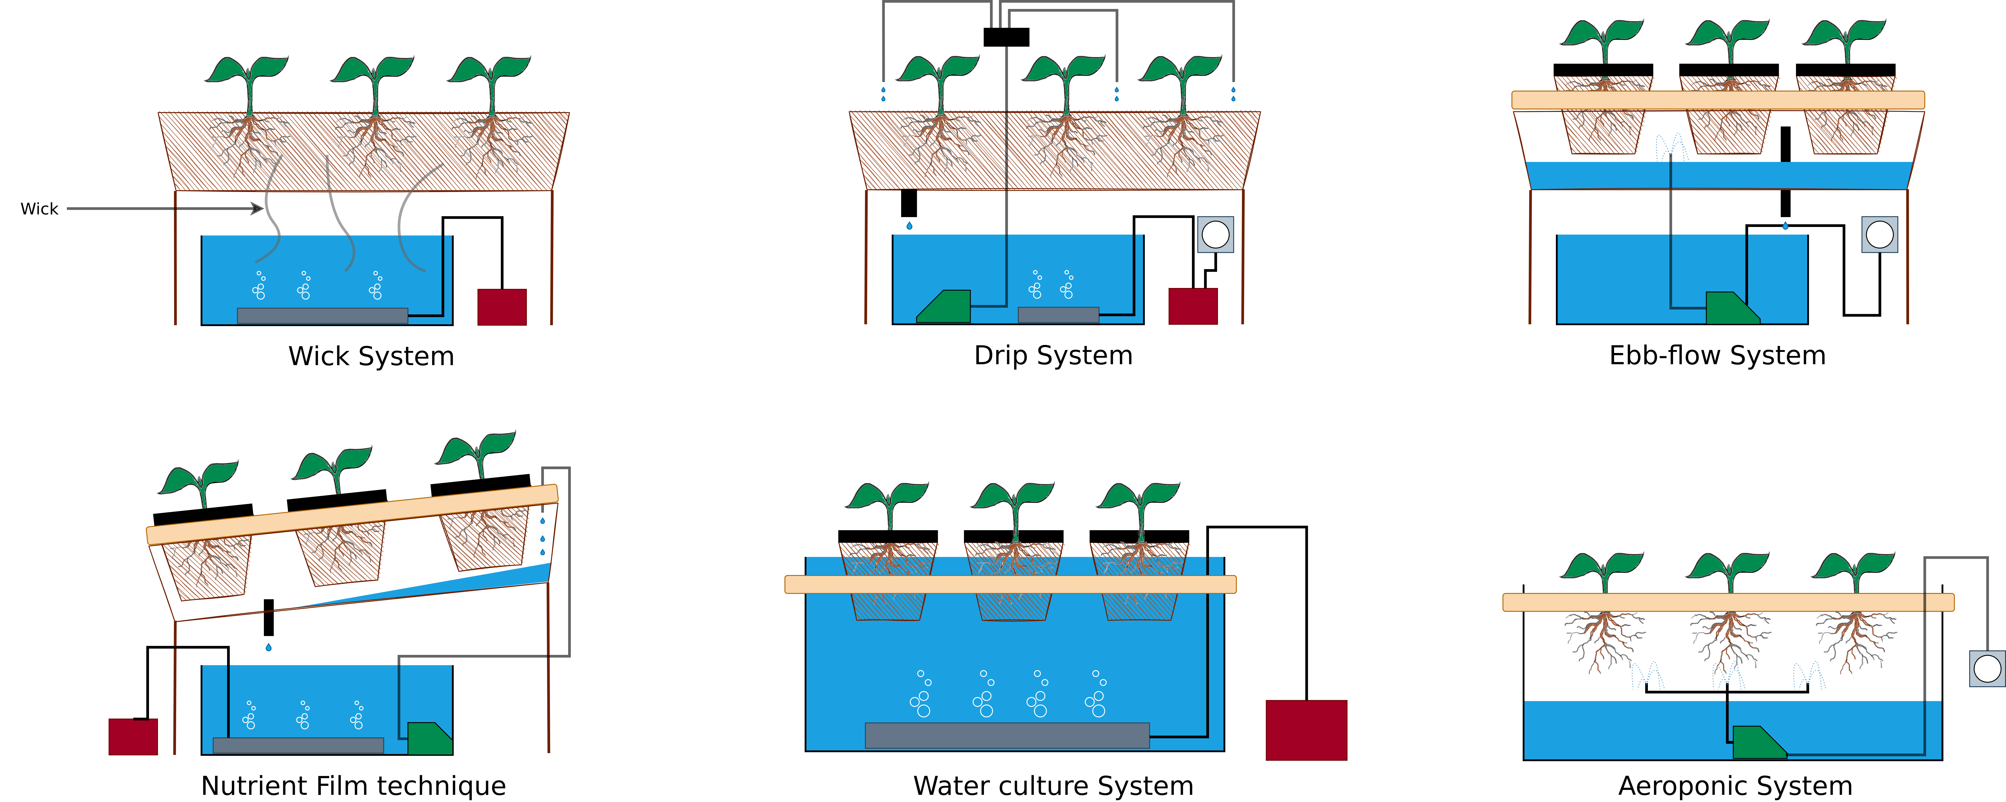
Climate-Resilient Food Production
Vertical Farming – Hydroponic Systems
Image adapted from: S. Lee, J. Lee (2015) – Beneficial bacteria and fungi in hydroponic systems: Types and characteristics of hydroponic food production methods – Link.
Plant graphic edited and adapted from original work titled “Gravel in Plant Container Causing Wet Soil Graphic” authored by “Garlan Miles” – Link.

Slide 33
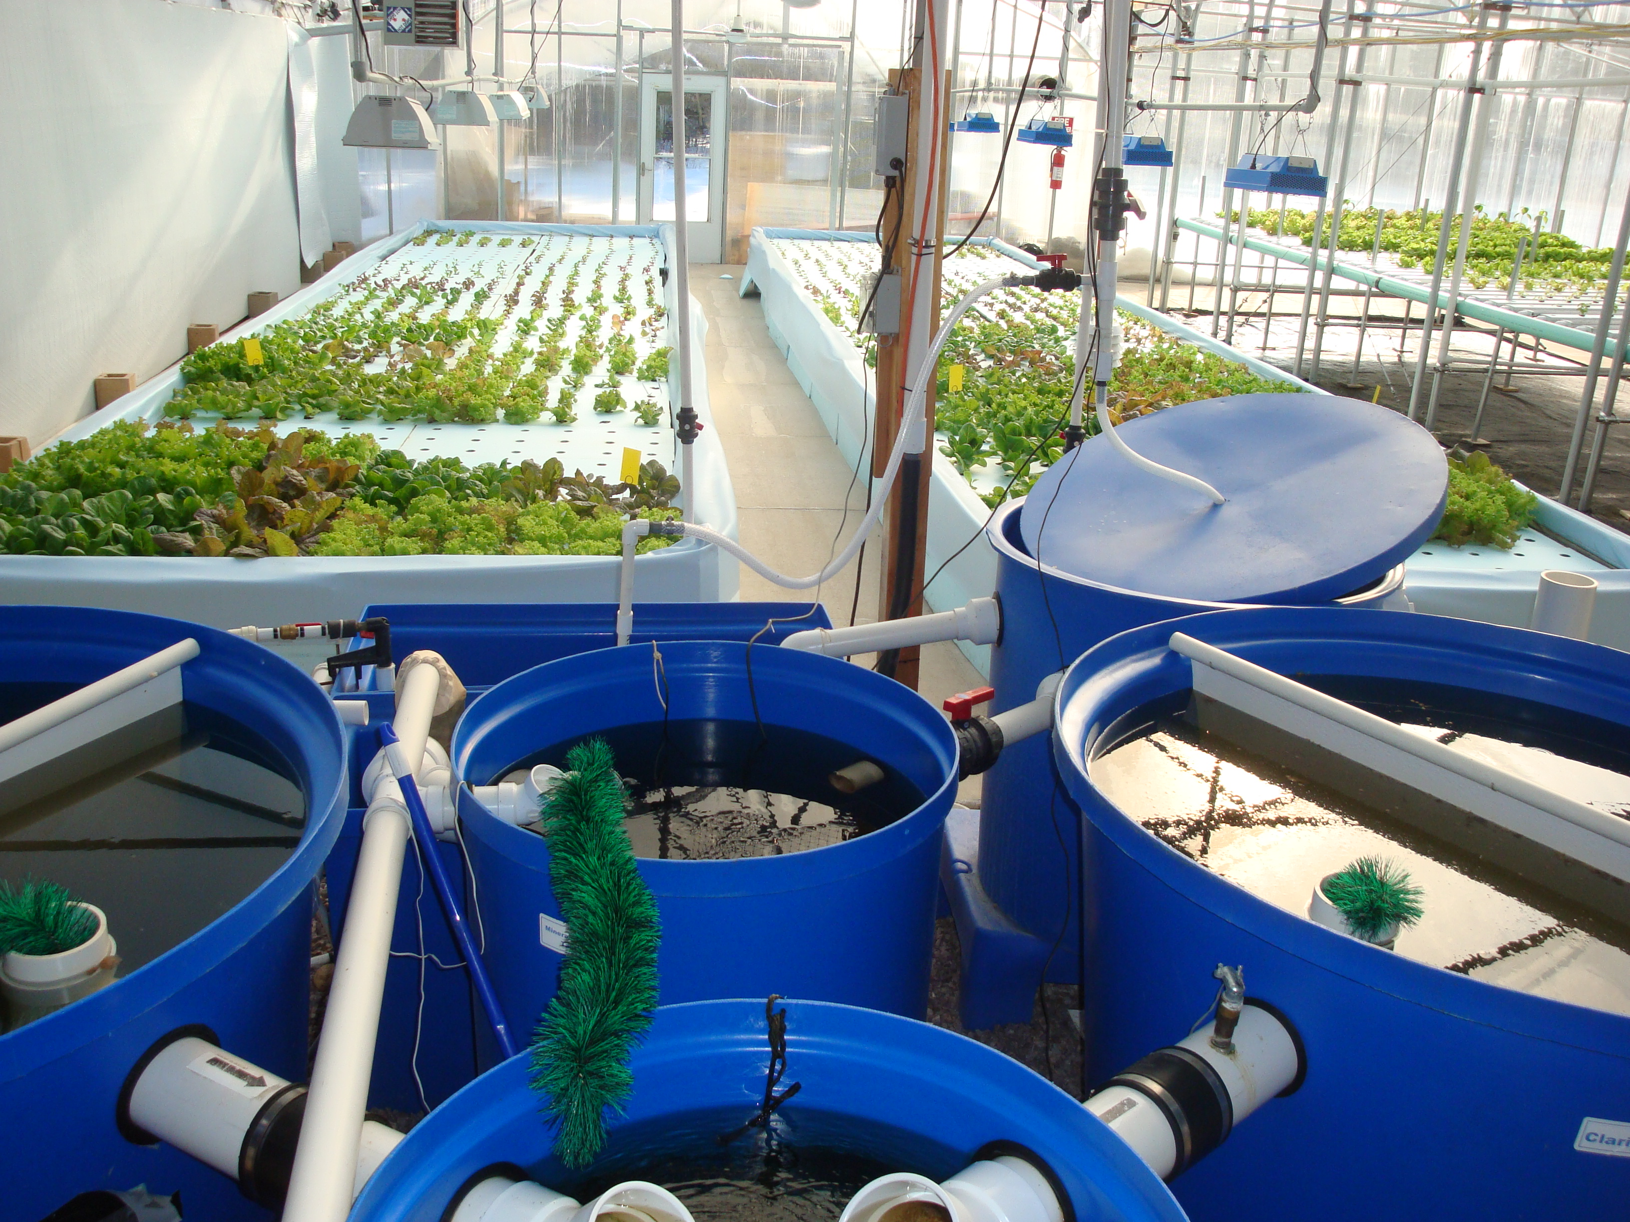
Climate-Resilient Food Production
Aquaponics
Kate Field – https://www.flickr.com/photos/gatewayhorticulture/6852357005 – CC BY-SA 2.0

Slide 34
Climate-Resilient Food Production
Aquaponics
Aquaponic spaceship on the Oker in Braunschweig → Link

Slide 35
Climate-Resilient Food Production
Aquaponics – What’s next?

Slide 36
Climate-Resilient Food Production
Aquaponics – What’s next?
Insects!

Slide 37
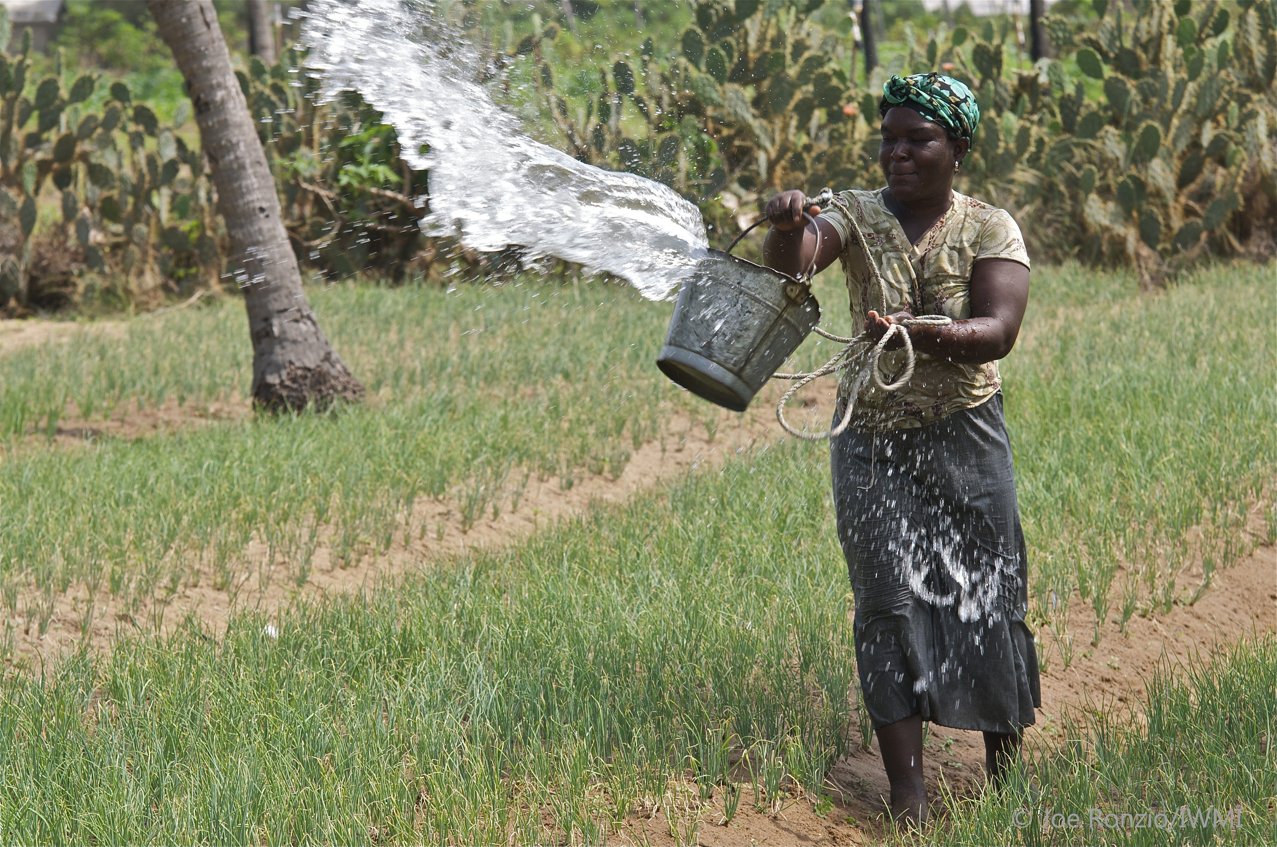
Climate-Resilient Food Production
Irrigation Management
IWMI Flickr Photos – https://www.flickr.com/photos/iwmi/8662458036 – CC BY-NC-ND 2.0

Slide 38
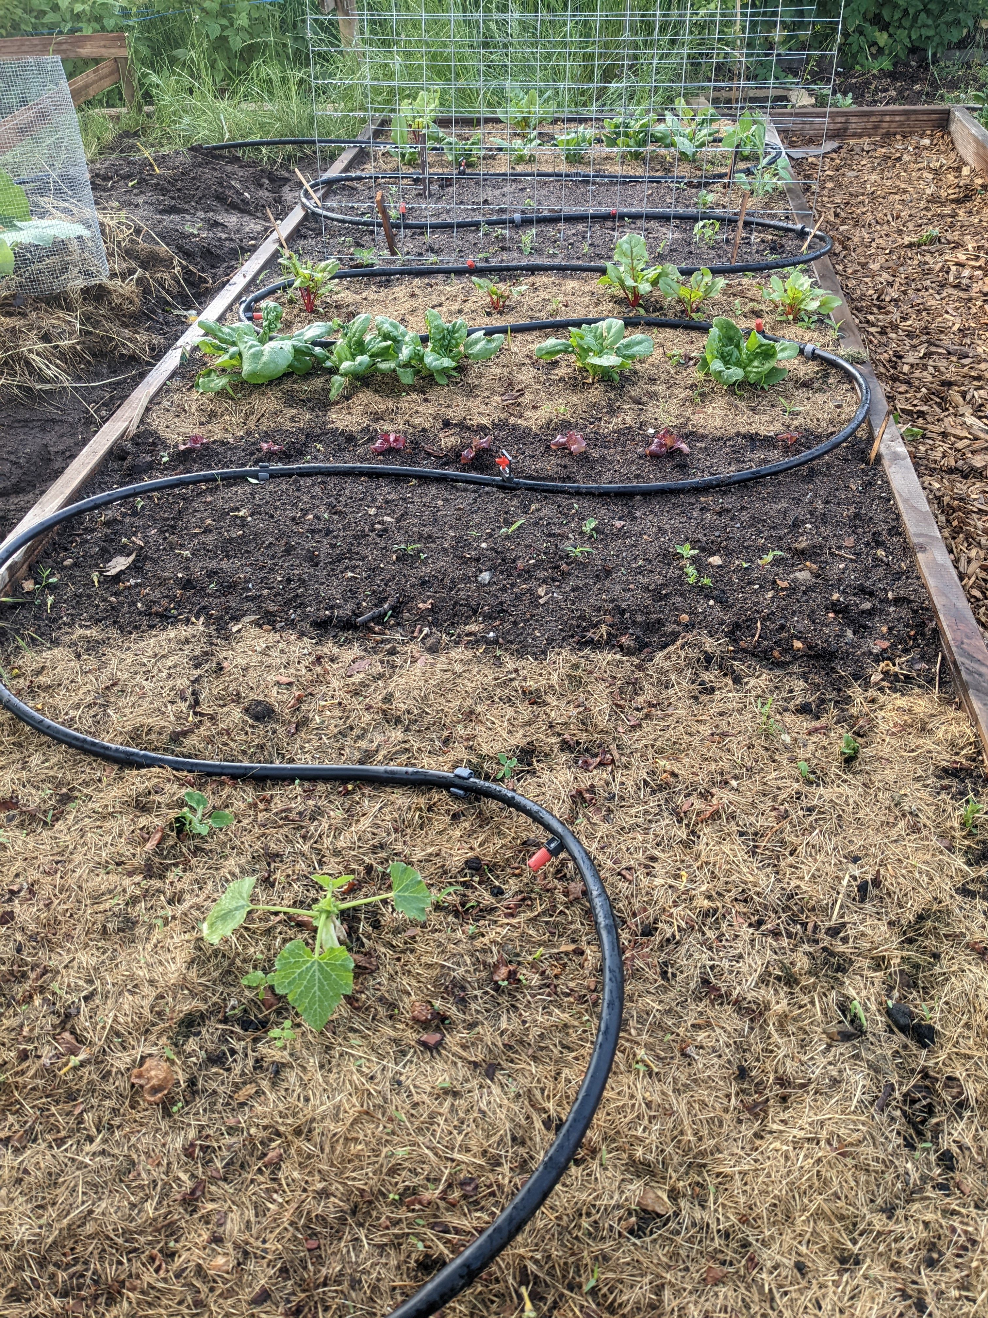
Climate-Resilient Food Production
Irrigation Management
1. IWMI Flickr Photos – https://www.flickr.com/photos/iwmi/8662458036 – CC BY-NC-ND 2.0
2. Benjamin Leiding – CC BY-SA 4.0

Slide 39
Climate-Resilient Food Production
Ecological (No/Low-Tech) Alternatives
Agroforestry → Trees/shrubs are grown around or among crops or pastureland (Link)
Permaculture → Growth of an agricultural ecosystem in a self-sufficient and sustainable way (Link)
Silvopasture → Trees, forage and domesticated animals in a mutually beneficial way
Etc.

Slide 40
OThers

Slide 41
Others
Overview
Green cement/steel/aluminum/...
Desalination
Water purification
Etc.

Slide 42
Conclusion

Slide 43
Conclusion
I am not saying that all sustainability-related technologies are bad!
However, business-as-usual in conjunction with sustainable technologies is not the solution, it is rather a supporting aspect
We are buying some time, that’s it
Most sustainability-related technologies are complex and require a lot of resources and energy
Also: Given a remaining set of resources and a remaining carbon budget → Which (emerging/sustainability-related) technologies can we afford to work on?

Slide 44
Additional Resources
How to Save a Planet – Electrify This! (Podcast) – Link
Food and Environment Reporting Network – Hot Farm (Podcast) – Link
D. Holmgren (2002). Permaculture: Principles & Pathways Beyond Sustainability
W. B. Arthuer (2011). The Nature of Technology – What It Is and How It Evolves

Slide 45
Questions?

